Slide 1
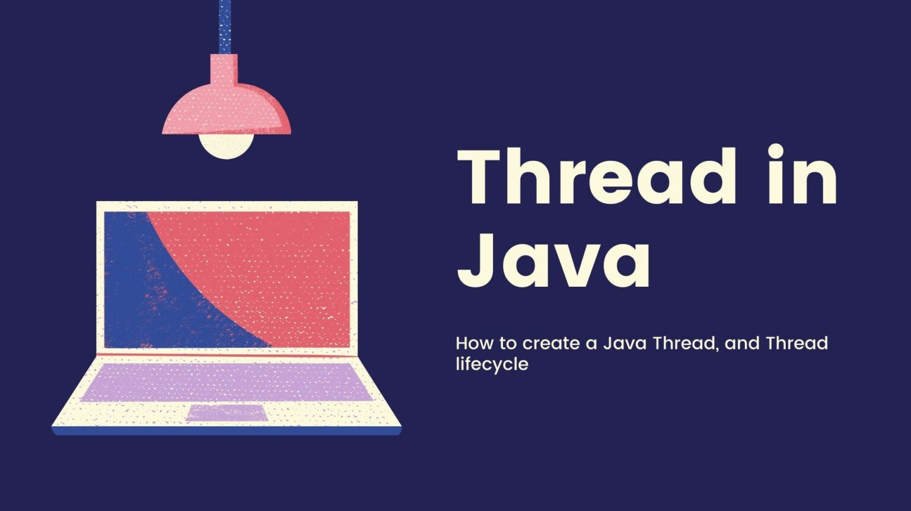

Slide 2
What is Thread ?
lightweight sub-process.
smallest unit of processing.
Multiprocessing and multithreading.
Achieve multitasking.

Slide 3

Ways to achieve Thread
1.Extends Thread class.
Override run () method.
Call the Start method.

Slide 4
Why is thread used?
increase performance.
To operate more efficiently.
Doing multiple things at same time.

Slide 5
Way to achive Thread
1. By extending Thread class
class A extends Thread {
public A (String name) { super (name); }
public void run () {
System.out.println(“My name is ” + getName());
}
}
class B {
public static void main (String [] args) {
A a = new A (“mud”);
a.start ();
}
}

Slide 6
Way to achive Thread
2 . By implementing Runnable interface.
class A extends ... implements Runnable {
public void run () {
System.out.println(“My name is ” + getName () );
}
}
class B {
public static void main (String [] args) {
A a = new A ();
Thread t = new Thread (a, “mud, too”);
t.start ();
}
}

Slide 7
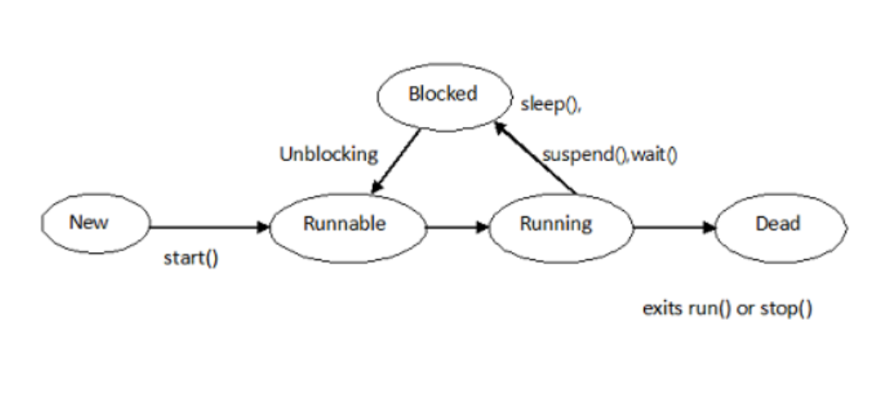
Life cycle of a Thread (ThreadStates)

Slide 8
Java Thread setPriority() method
The setPriority()method of thread class is used to change the thread's priority. Every thread has a priority which is represented by the integer
public static intMIN_PRIORITY:
It is the maximum priority of a thread. The value of it is 1.
public static intNORM_PRIORITY
It is the normal priority of a thread. The value of it is 5.
public static intMAX_PRIORITY:
It is the minimum priority of a thread. The value of it is 10.

Slide 9
Thread Scheduler in Java
1 . Thread scheduler in java is the part of the JVM that decides which thread should run.
2 . Only one thread at a time can run in a single process.

Slide 10
Thread Synchronization
It’s a technic to control multiple thread.
Allow one thread at a time.
2 . Synchronized block is used to lock an object for any shared resource.

Slide 11
Any Question
?

Slide 12
Thank You…

